Slide 1
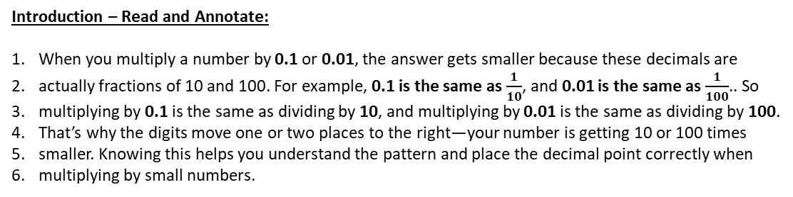



Subtopic N3.17 – Multiplying by 0.1 and 0.01 (CHALLENGE)
LEARNING OUTCOME: To multiply numbers by 0.1 and 0.01
Keywords:
Multiply
Divide
Integer
Decimal
Objectives:
Multiply numbers by 0.1 and 0.01.
Multiply numbers by 0.1 and 0.01.
Decimal | Place value | Fraction
0.1 | One tenth
0.01 | One hundredth
Example 1 - I do…
Example 2 – We do…
Example 3 – You do…
Steps | Calculate: | Calculate: | Calculate:
1) Determine which way the digits move when we multiply by 10, 100, 1000… 2) Work out how many places we need to move the digits. 3) Move the digits in the correct direction, by the number of places.
Multiplying by 0.1 is the same as dividing by ____10______.
Multiplying by 0.01 is the same as dividing by ____100______.

Slide 2

























Independent Practice
1. Calculate the following:
2. Complete these statements using one of these symbols:
<
>
=
<
>
>
=
3. Put the results of these calculations in order, starting with the smallest

Slide 3
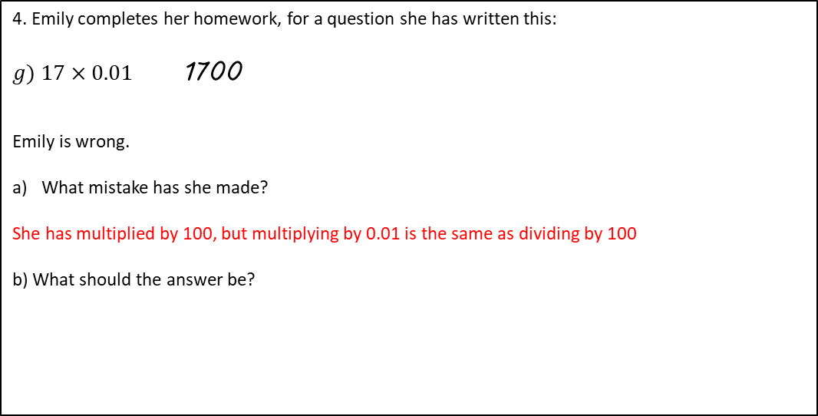
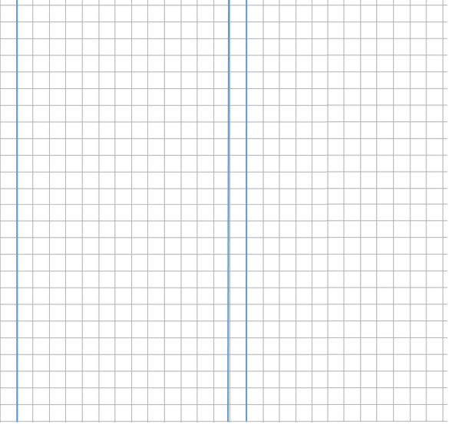
0.17
Skills Check

